Slide 1
911Kaggle
TBC Team
(aka the best!!)

Slide 2
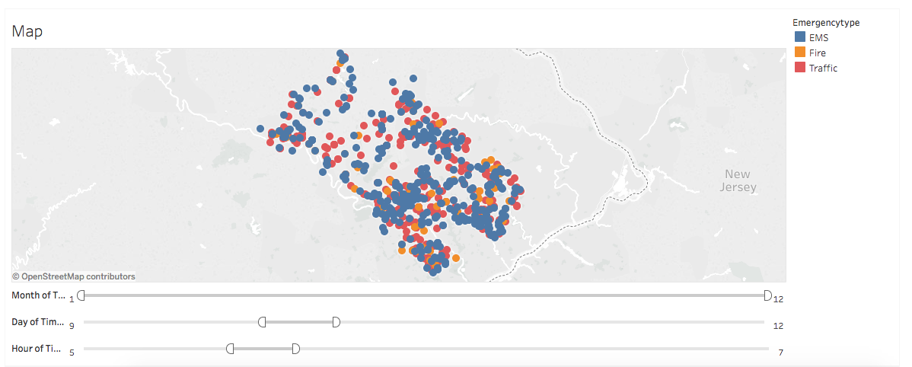
Visualisation
Tableau:
https://public.tableau.com/profile/publish/kaggle911/Map#!/publish-confirm

Slide 3
98.8%
The result is so good!!!
https://github.com/tkjyeung/911Kaggle/blob/master/911Kaggle%20code.ipynb

Slide 4
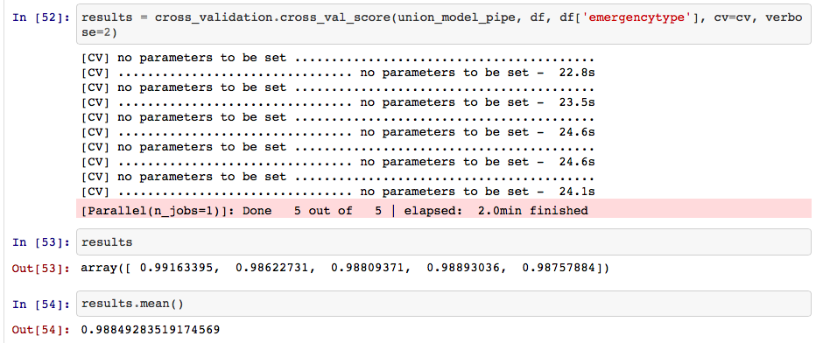
iPython Notebook:

Slide 5
~The End~
Team = { ‘CEO’ : “Jacky” ,
‘CFO’ : ‘Anthony’ ,
‘CRO’ : ‘Sid’ ,
‘CIO’ : ‘Alex’ ,
‘CTO’ : ‘BoKi’ ,
‘UFO’ : ‘Bryant’ }

